Slide 1
presentation on mini project
Rojila santhosh
22pmc146

Slide 2
abstract
The COVID-19 pandemic has highlighted the critical importance of efficient quarantine management systems in curbing the spread of infectious diseases. is to help people through the unfortunate virus outbreak. The QMS offers a user-friendly web or mobile interface for individuals to register and provide essential personal and contact information. The website provide information about the quarantine centers in each district and the users will be able to search location by district and choose available centers. The Quarantine Management System offers a comprehensive solution to enhance the efficiency and safety of managing quarantine facilities.

Slide 3
The proposed system is completely integrated online and the users are needed to register in order to book a house to stay. Its implementation can significantly contribute to minimizing the spread of contagious diseases and maintaining the well-being of individuals under quarantine.

Slide 4
requirements
User Registration and Authentication.
User can view houses on home page.
Search functionality.
House booking.
Document upload and verification.
Owner approve or reject user booking.
Owner add houses.

Slide 5
Features and highlights
There are 3 users in the system admin, owner, user.
User can search a house based on location and capacity.
During booking user can select check in and check out date.
Users can upload documents while booking
Owner verifies the documents upload by user and approve or reject bookings.
Owner can add stay homes details.
Admin approves or reject the owner based on the documents they upload during registration
The owner will be able to login to the system if the admin approves him/her.

Slide 6
third party libraries
Django-jazzmin: a drop-in app to jazz up your Django admin site, with plenty of things you can easily customize, including a built-in UI customizer.
Pillow: Pillow library is for image processing tasks such as opening, manipulating, and saving images.

Slide 7
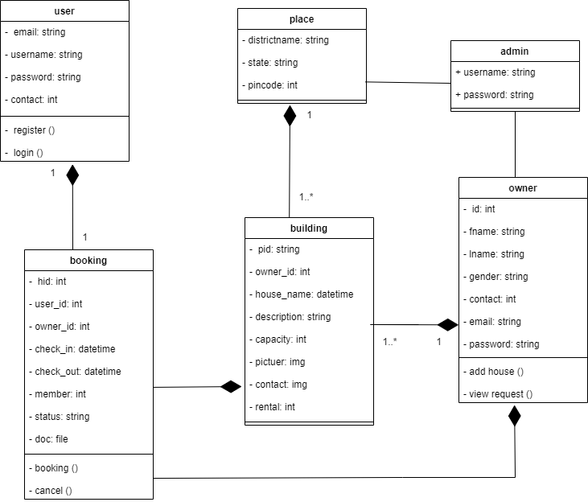
class diagram

Slide 8
challenges faced
When it comes to the validation area i found difficulties in validating check in and check out fields.
I felt its difficult to set the validation for a home stay date for a particular house taken by one person can’t be taken by another one.
The documents uploaded by the owner during registration should be approved by the admin.Implementing this condition into my project was difficult

Slide 9
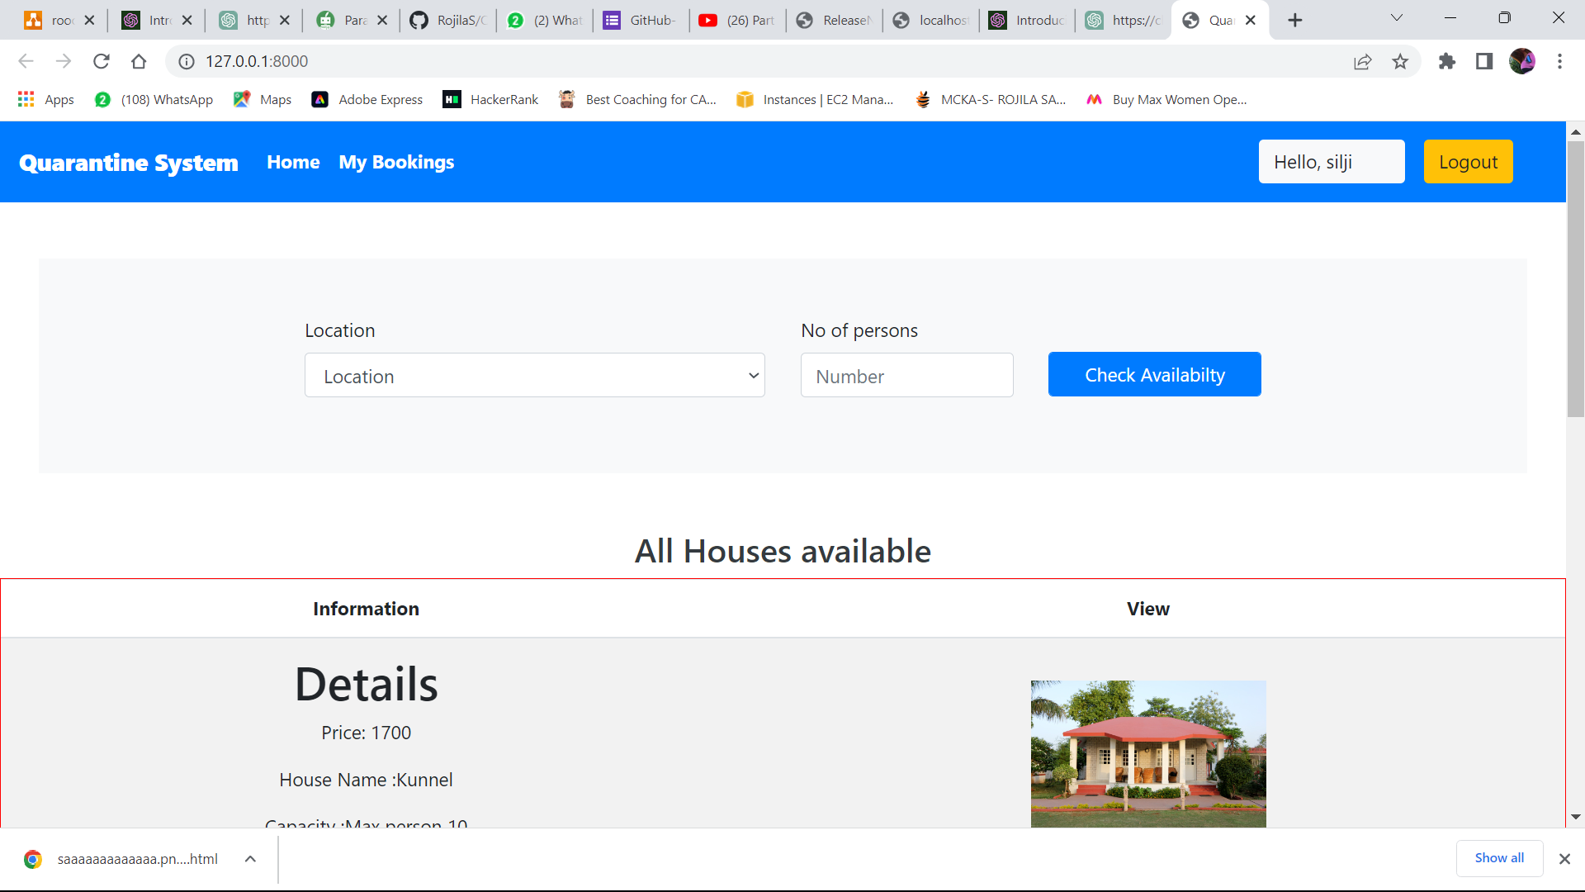
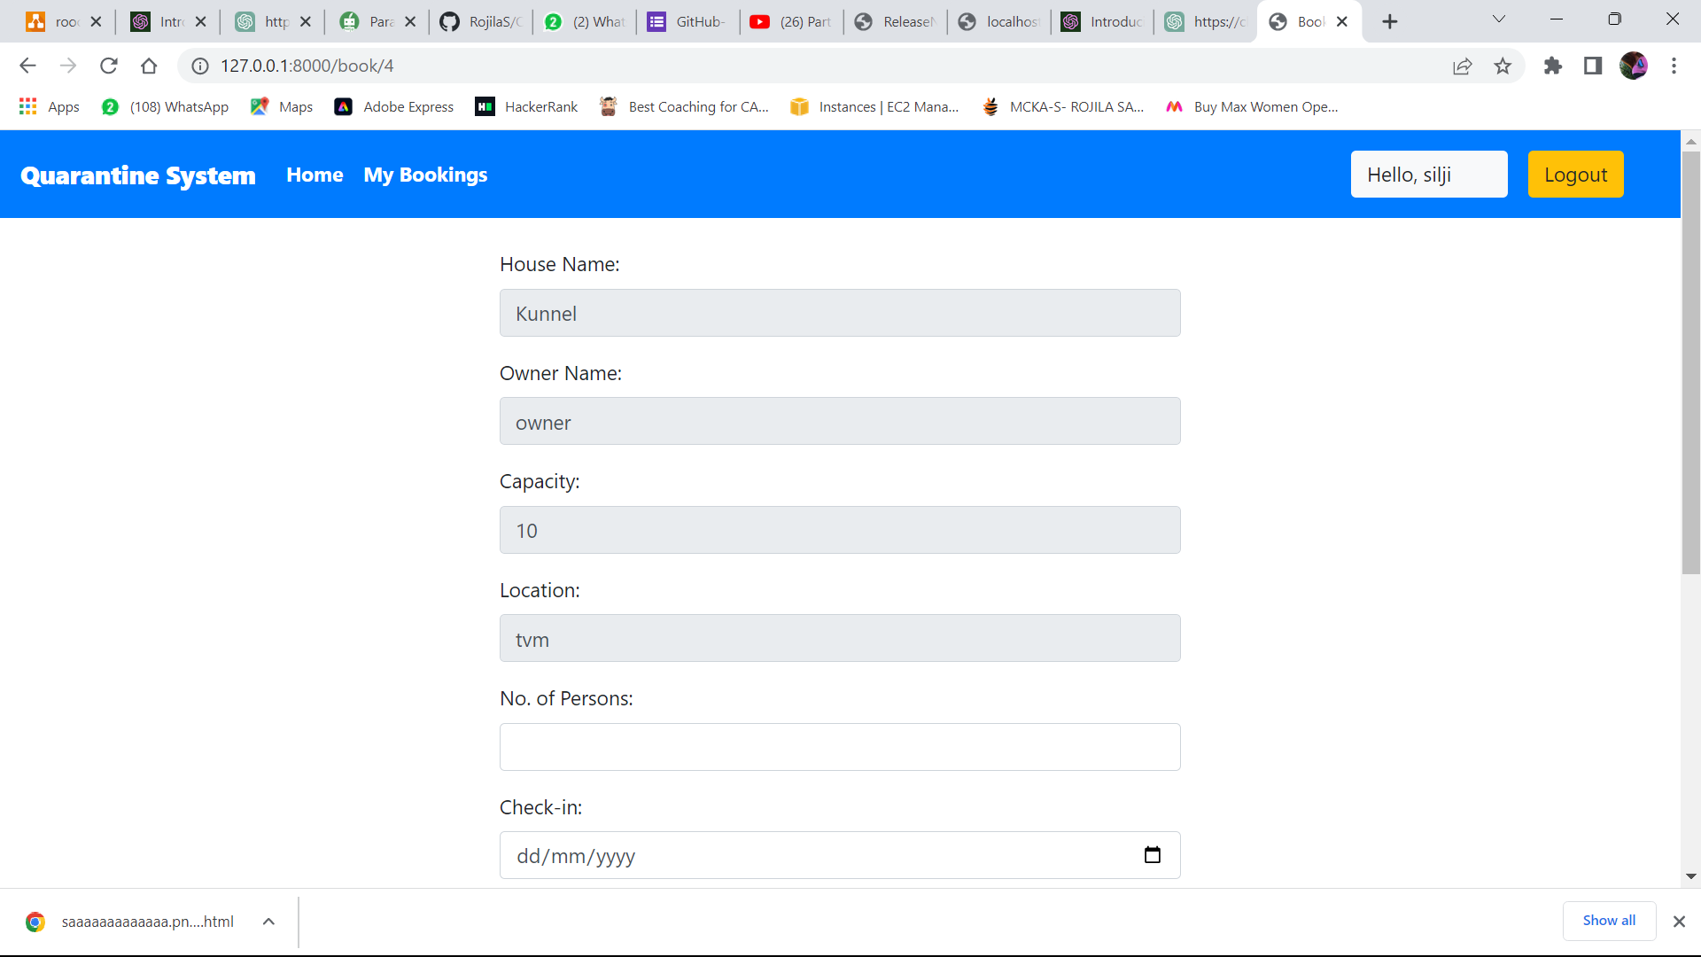
screenshots
User home page
User stay home booking page

Slide 10
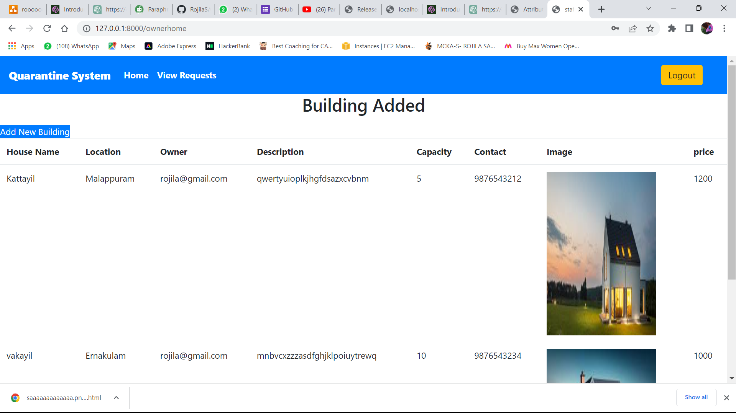
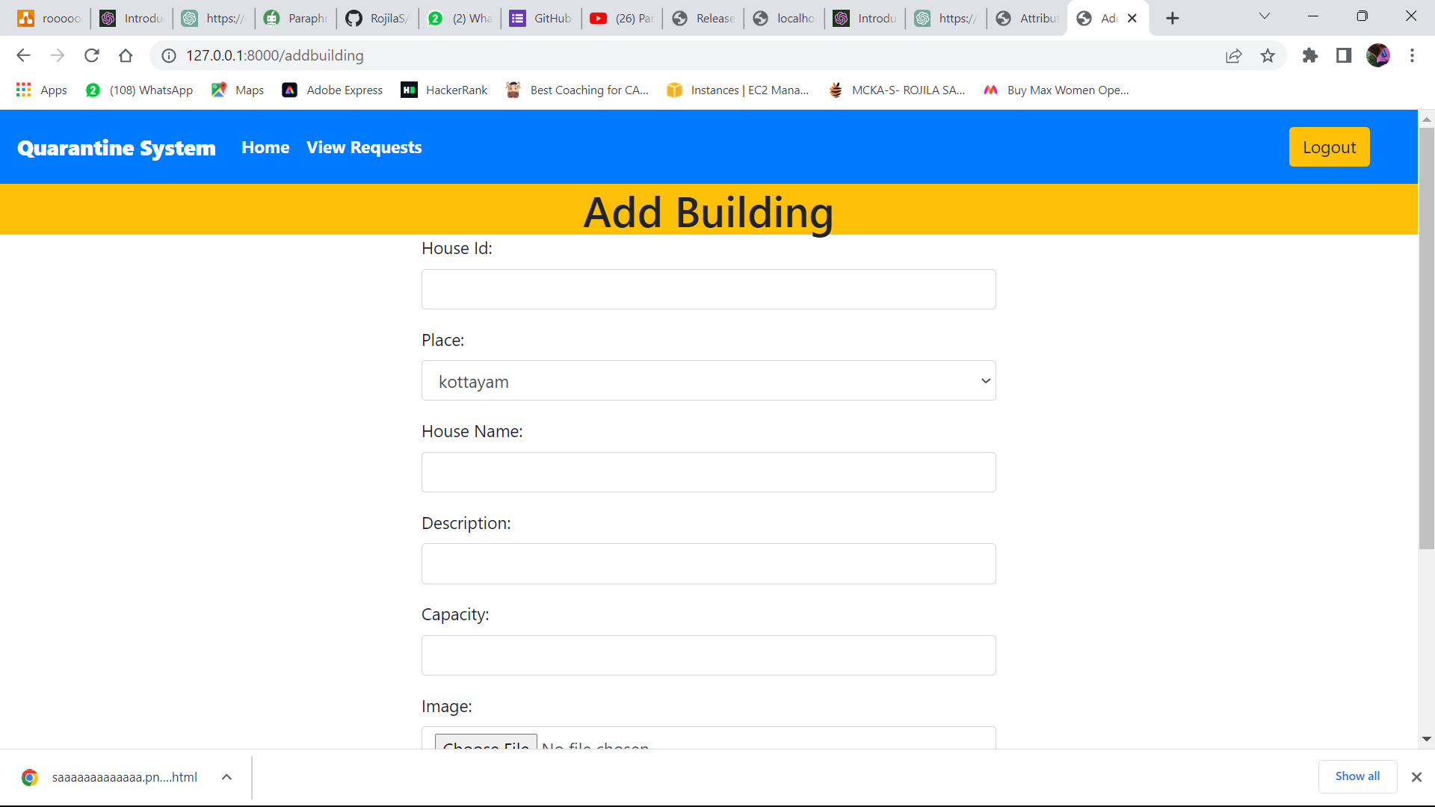
Owner home page
Stay home details adding page

Slide 11
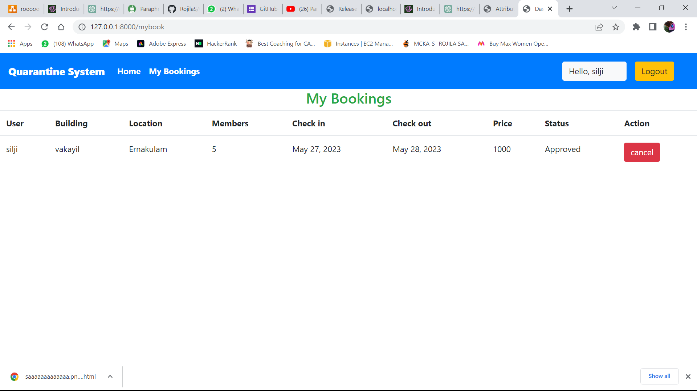
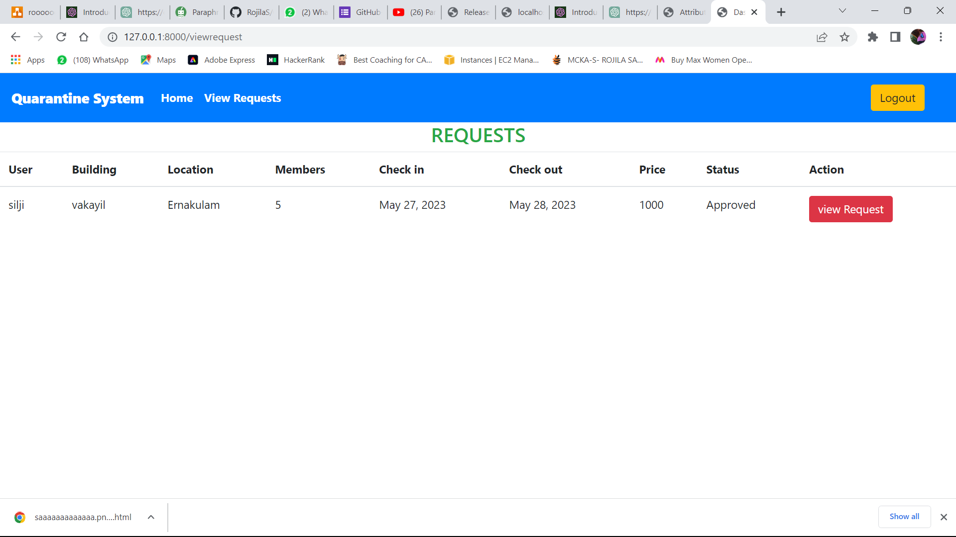
My bookings where users can see their booking
Owner can see the booking request that user send.

Slide 12
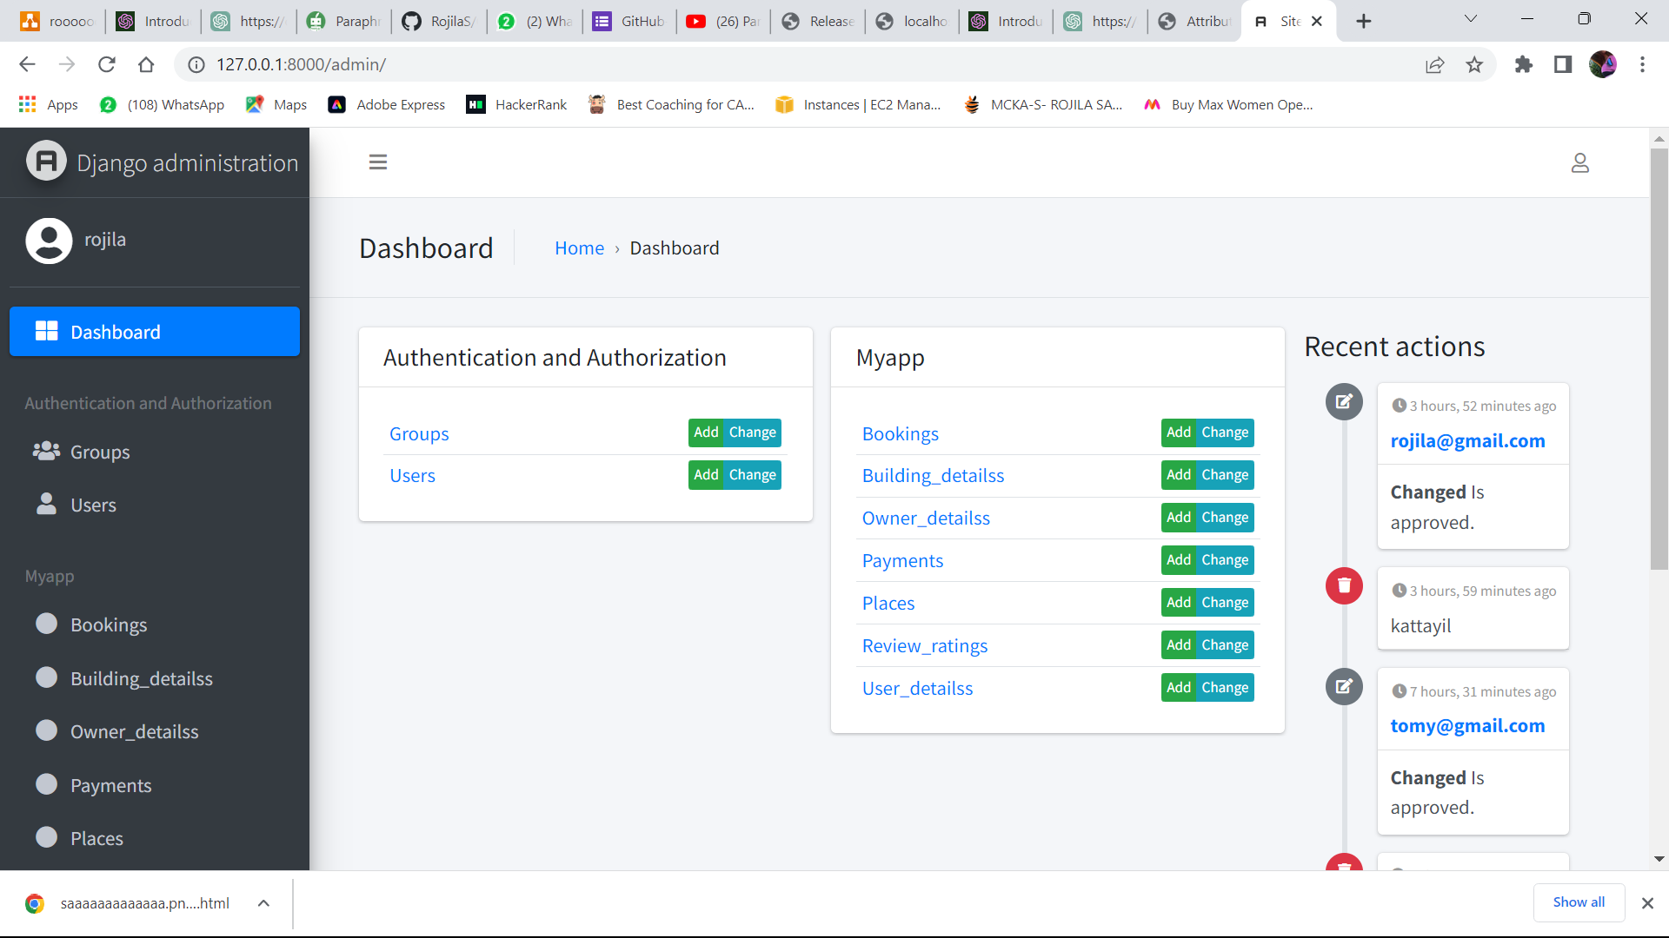
Admin dashboard

Slide 13
Future enhancement
Payment option.
Chat option between users and owner
Daily updates of covid positive.

Slide 14
conclusion
In conclusion, a quarantine home management system is a vital tool for efficiently and effectively managing individuals' isolation and quarantine periods.The system provides an easy medium for citizens to access its features. The objective of the project is to provide an online portal for the user. The purpose is to design a system which reduces the burden of having to visit people and house for rent.

Slide 15
reference
https://www.mohfw.gov.in/
https://www.fabhotels.com/hotels-with-quarantine-facility
https://www.travelguru.com/hotels/quarantine-self-isolation-hotels-in-cochin

